Slide 1
Use Cases
CS 3450
Introduction to Software Engineering

Slide 2
Use Cases
Use cases provide examples of activities that a user can do on your system
Use cases should cover EVERY possible case of actions
For the purpose of this class, we will do a maximum of 15 use cases
This is where you start to refine what a user is capable of doing on your system
Use cases contain the following elements:

Slide 3

Actor
Actors are anything capable of using your system
User, Admin, etc…
The stick figure is in fact UML standard
All actors should have a label

Slide 4

Action
Actions state what an actor is capable of doing
These should be stated as simply as possible
More explanation will come later

Slide 5

Connection
This connects an action
Do NOT use arrows
Arrows imply something completely different which we will learn later

Slide 6
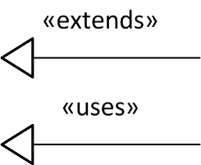
Uses / Extends
If an action uses or extends another action, use this arrow AND text to point to the extended / used action

Slide 7
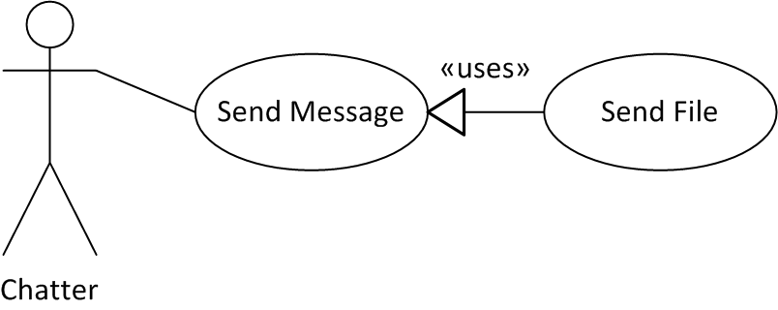
Full Diagram
This is what a full diagram looks like
This is more than most diagrams will require
Most will be an actor and action only
This isn’t all, one more part…

Slide 8
Action Text
The text goes over the specifics of the action
Should be step-by-step and very specific
PRIMARY ACTOR:
Chatter
GOAL:
Send a message to another user
TRIGGER
User wishes to send a message
FLOW:
User creates a message
User clicks send button
Message is sent to other user
Message is displayed on other computer
EXCEPTIONS:
User decides not to send message

Slide 9
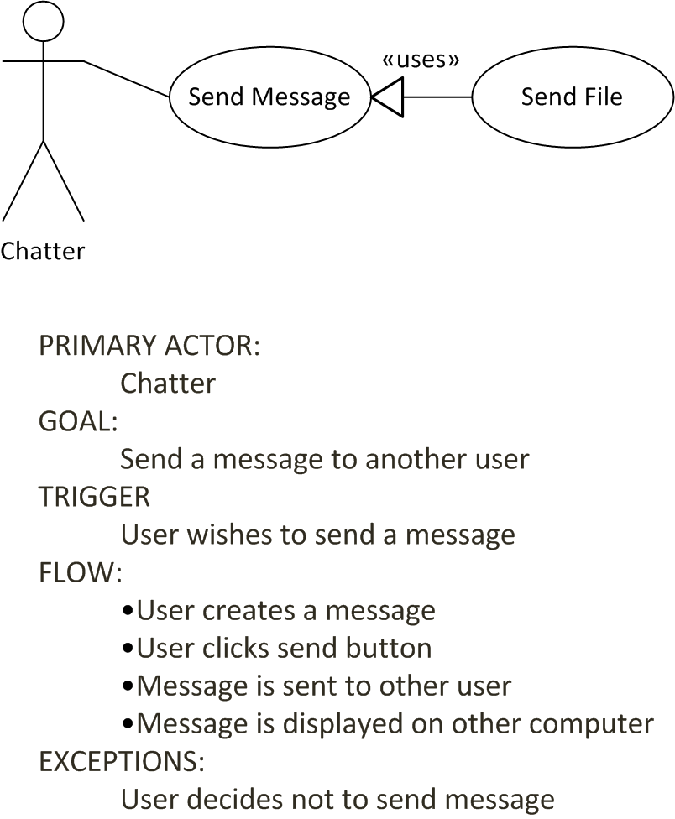
Put all together

Slide 10
Remember
Don’t be too specific, this is still something that the customer reads
Don’t use arrows between the Actor and the Action. Arrows are used if the Action uses / extends another action
When an arrow is used, it points towards the extended action
Each finished use case should look essentially similar to the one I have shown
Before all of the use cases, you should have a FULL use case diagram, this shows all actors and actions and how they interact with each other

